Slide 1
SINGLE ELECTRON TRANISITOR
Presented by SHANTHINI.S

Slide 2
SINGLE ELECTRON TRANSISTOR
A single-electron transistor (SET) is a switching device that consists of two tunnel junctions sharing a common electrode and makes use of this controlled electron tunneling for amplification of current. The technology used in single-electron transistors is based on the theory of quantum tunneling. Considered an important component of nanotechnology, single-electron transistors provide high operating speed and low power consumption.

Slide 3
CONSTRUCTION
A single-electron transistor is usually made by keeping two tunnel junctions in series. The transistor consists of a source electrode and a source drain, which is joined with the help of a tunneling island that is also capacitively connected to a gate. The electrons can travel to another electrode only through the insulator. There are two categories of single-electron transistors: metallic and semiconducting. The former makes use of a metallic island, and its electrodes using a shadow mask are mostly evaporated onto an insulator. The latter, in contrast, depends on severing the two-dimensional electron gas that forms at the interface of the semiconductors for the junction.

Slide 4
WORKING PRINICIPLE
Single-electron transistors (SETs) are essential elements of ULSI logic circuit design. A three terminal switching device in which the effect of coulomb blockade can be observed is generally known as single-electron transistor. Unlike field - effect transistors, single-electron transistors are based on an intrinsically quantum phenomenon which is known as „Tunnel effect.’ This tunnel effect may be observed when two metallic electrodes are separated by an insulating barrier known as tunnel junction. These three terminal switching devices can transfer electrons form source to drain one by one. The schemetic diagram of SET

Slide 5
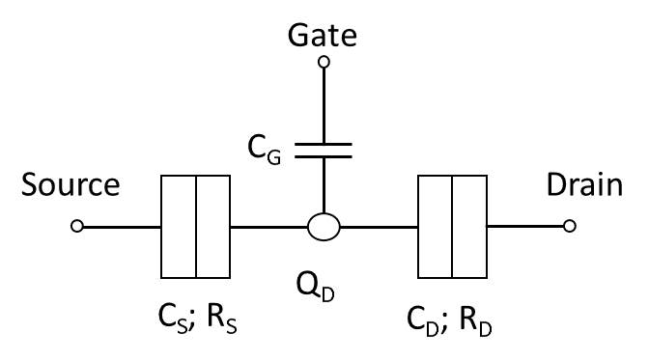
SCHEMATIC DIAGRAM OF SET

Slide 6
The Single-electron transistors (SETs) are efficient charge sensors for reading out spin or charge qubits confined in quantum dots (QDs). To investigate their capacitive parameters, which are related to the signal-to-noise ratio (SNR) during qubit readout, twin silicon single QDs were fabricated using a lithographic process on a silicon-oninsulator substrate. Since the configuration and dimensions of the QDs could be determined by direct imaging, the theoretical capacitive parameters could be compared to the measured values. Good agreement was found between the calculated and measured value, which confirms the validity of the calculation method. The results indicated that decreasing the SET diameter reduces the capacitive coupling between qubits but increases the signal-to-noise ratio for both dc and radio frequency singleshot measurements. Since these results are independent of the device materials, they are useful for establishing guidelines for the design of SET charge sensors in lateral QD-SET structures based on a two-dimensional electron gas. 2.2 Detection of Infrared Radiation The single-electron transistor can also be used to detect infrared signals at room temperature. By exciting electrons over an electrically induced energy barrier, both the range of detectable wavelengths and the sensitivity of the device can be controlled. The sensor works when an infrared signal excites conduction-band electrons in a 25-nmdeep

Slide 7
Application –charge sensor
The Single-electron transistors (SETs) are efficient charge sensors for reading out spin or charge qubits confined in quantum dots (QDs). To investigate their capacitive parameters, which are related to the signal-to-noise ratio (SNR) during qubit readout, twin silicon single QDs were fabricated using a lithographic process on a silicon-oninsulator substrate. Since the configuration and dimensions of the QDs could be determined by direct imaging, the theoretical capacitive parameters could be compared to the measured values. Good agreement was found between the calculated and measured value, which confirms the validity of the calculation method. The results indicated that decreasing the SET diameter reduces the capacitive coupling between qubits but increases the signal-to-noise ratio for both dc and radio frequency singleshot measurements. Since these results are independent of the device materials, they are useful for establishing guidelines for the design of SET charge sensors in lateral QD-SET structures based on a two-dimensional electron gas. 2.2 Detection of Infrared Radiation The single-electron transistor can also be used to detect infrared signals at room temperature. By exciting electrons over an electrically induced energy barrier, both the range of detectable wavelengths and the sensitivity of the device can be controlled. The sensor works when an infrared signal excites conduction-band electrons in a 25-nmdeep

